Slide 1
Hotel Reservation Analysis: Insights from Tableau
Unveiling Trends in Booking Rates, Occupancy, Demographics, and Revenue
BY LARISSA C. ONYEAKAGBU

Slide 2
INTRODUCTION TO HOTEL ANALYSIS IN TABLEAU
"Welcome to my Hotel Analysis in Tableau presentation. This insightful analysis delves into the dynamics of our hotel reservations, utilizing Tableau's powerful visualizations to unravel key trends in booking rates, occupancy, customer demographics, and revenue. Through comprehensive data exploration and visualization, we aim to uncover actionable insights that drive informed decision-making, optimize operational strategies, and enhance the guest experience. Join me as I navigate through the visual representations of a hotel's performance, illuminating valuable patterns and trends derived from raw data."

Slide 3
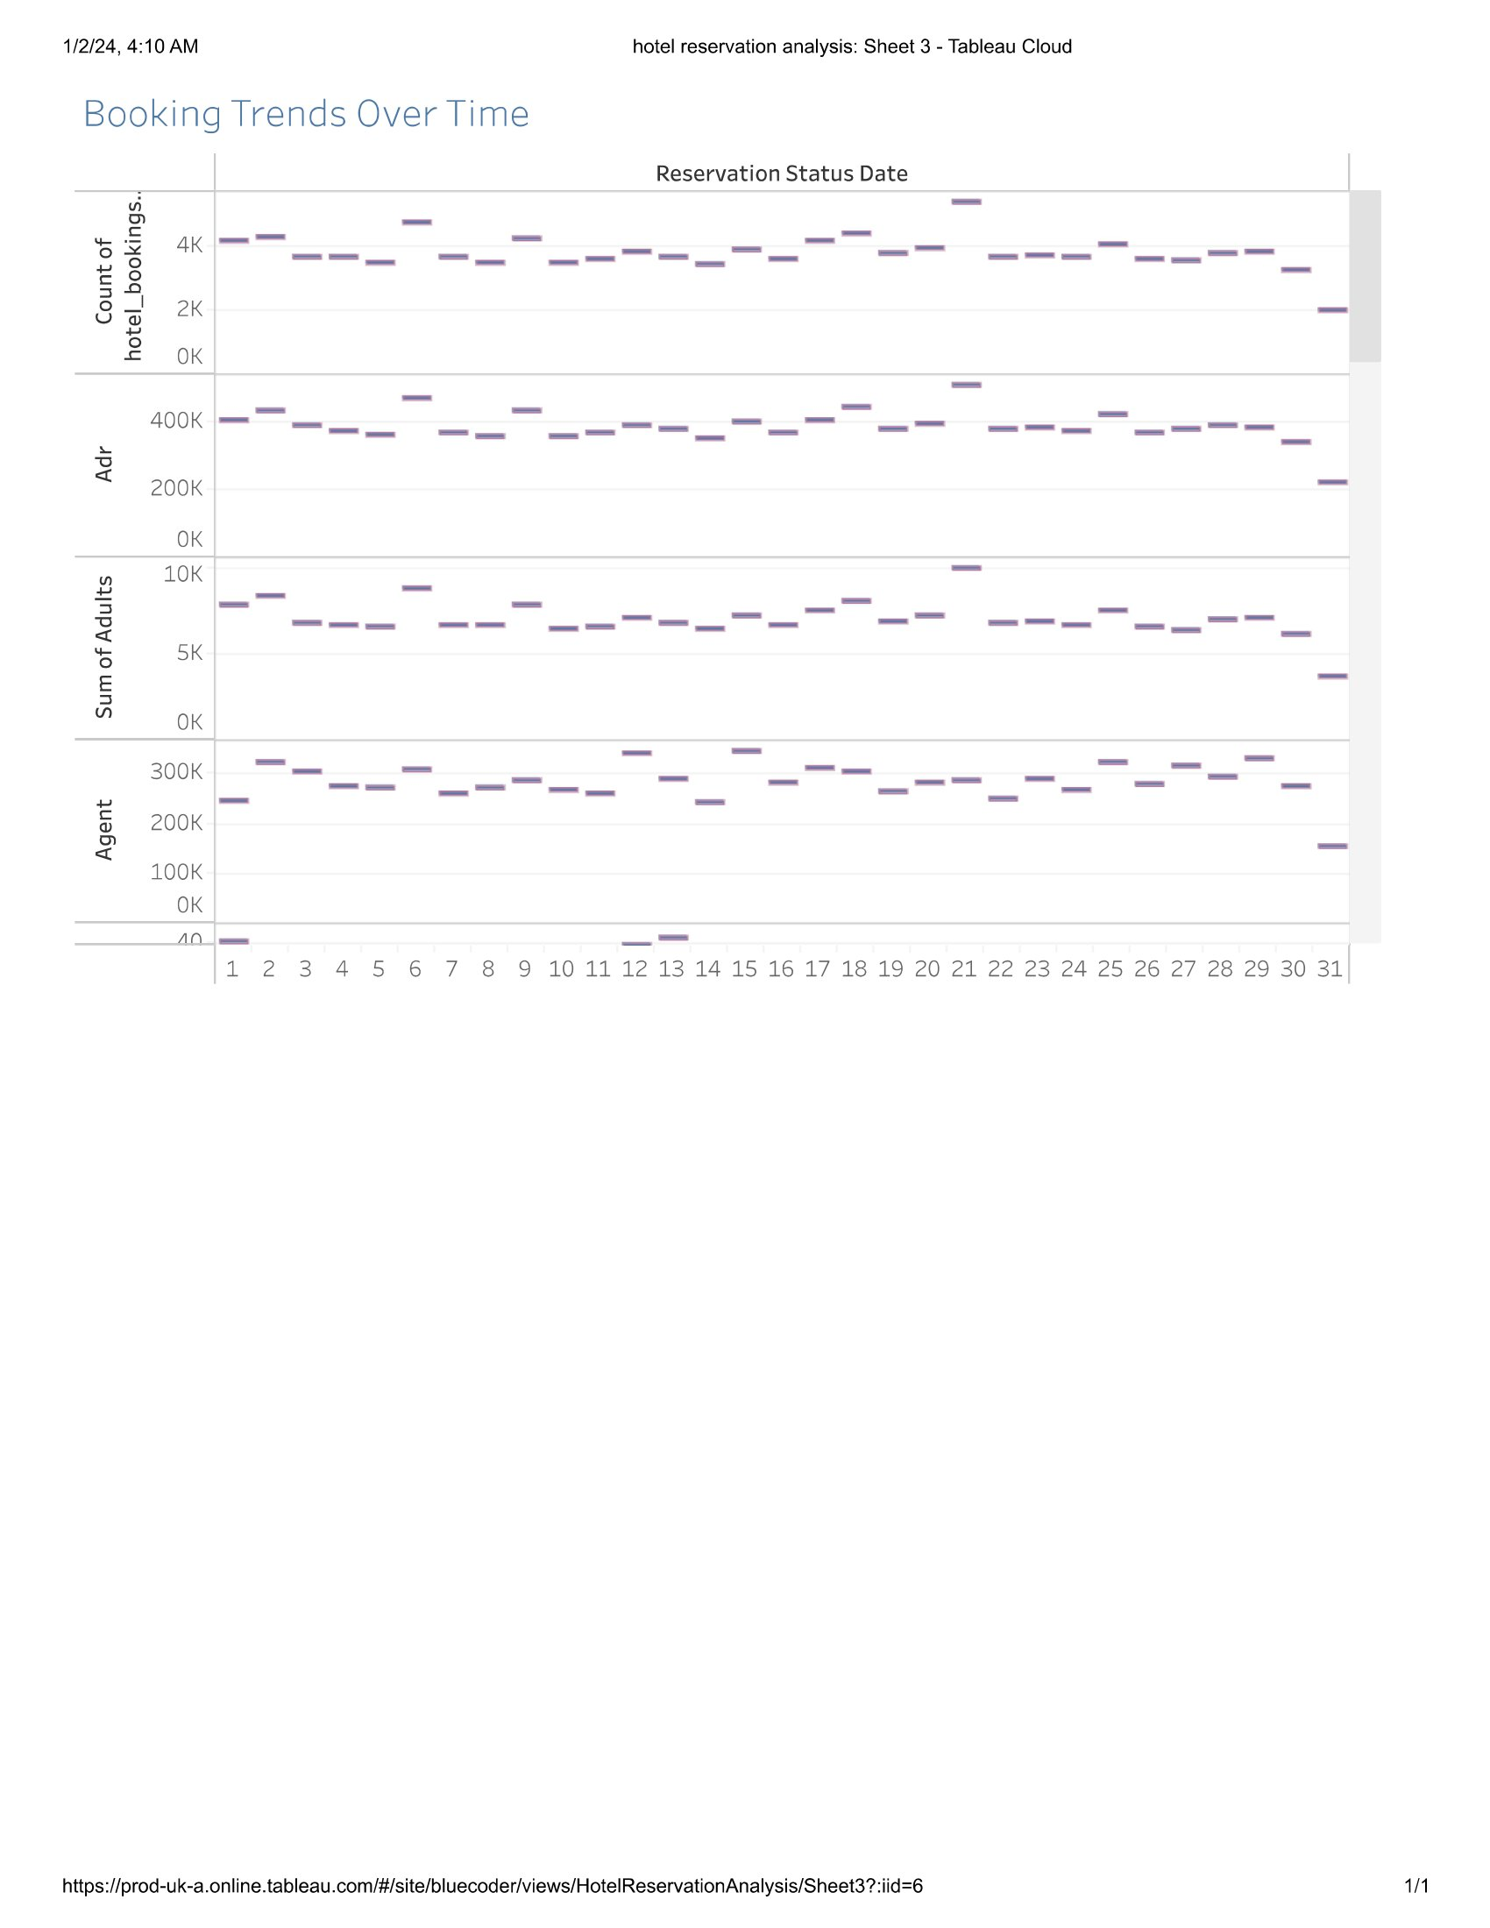
Tableau Line Chart showcasing booking trends over time.
Key findings: Peak booking periods and seasonal variations.

Slide 4
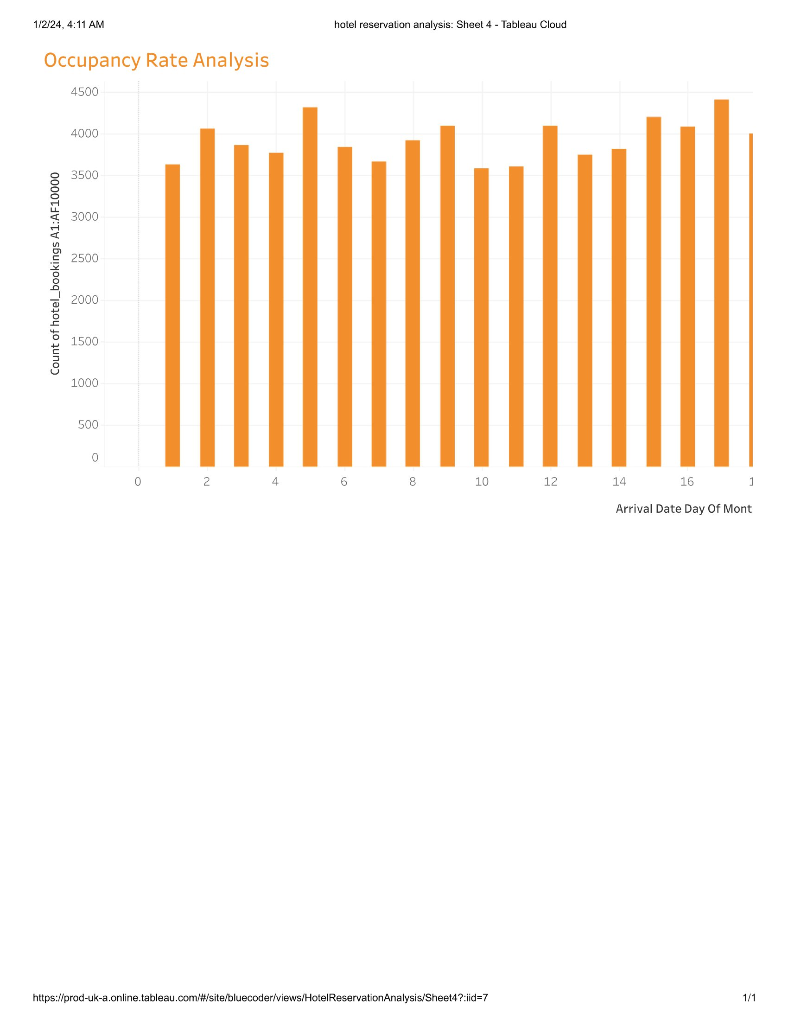
Tableau Bar Chart illustrating occupancy rates during specific periods.
Insights: Impact of room availability on overall occupancy.

Slide 5
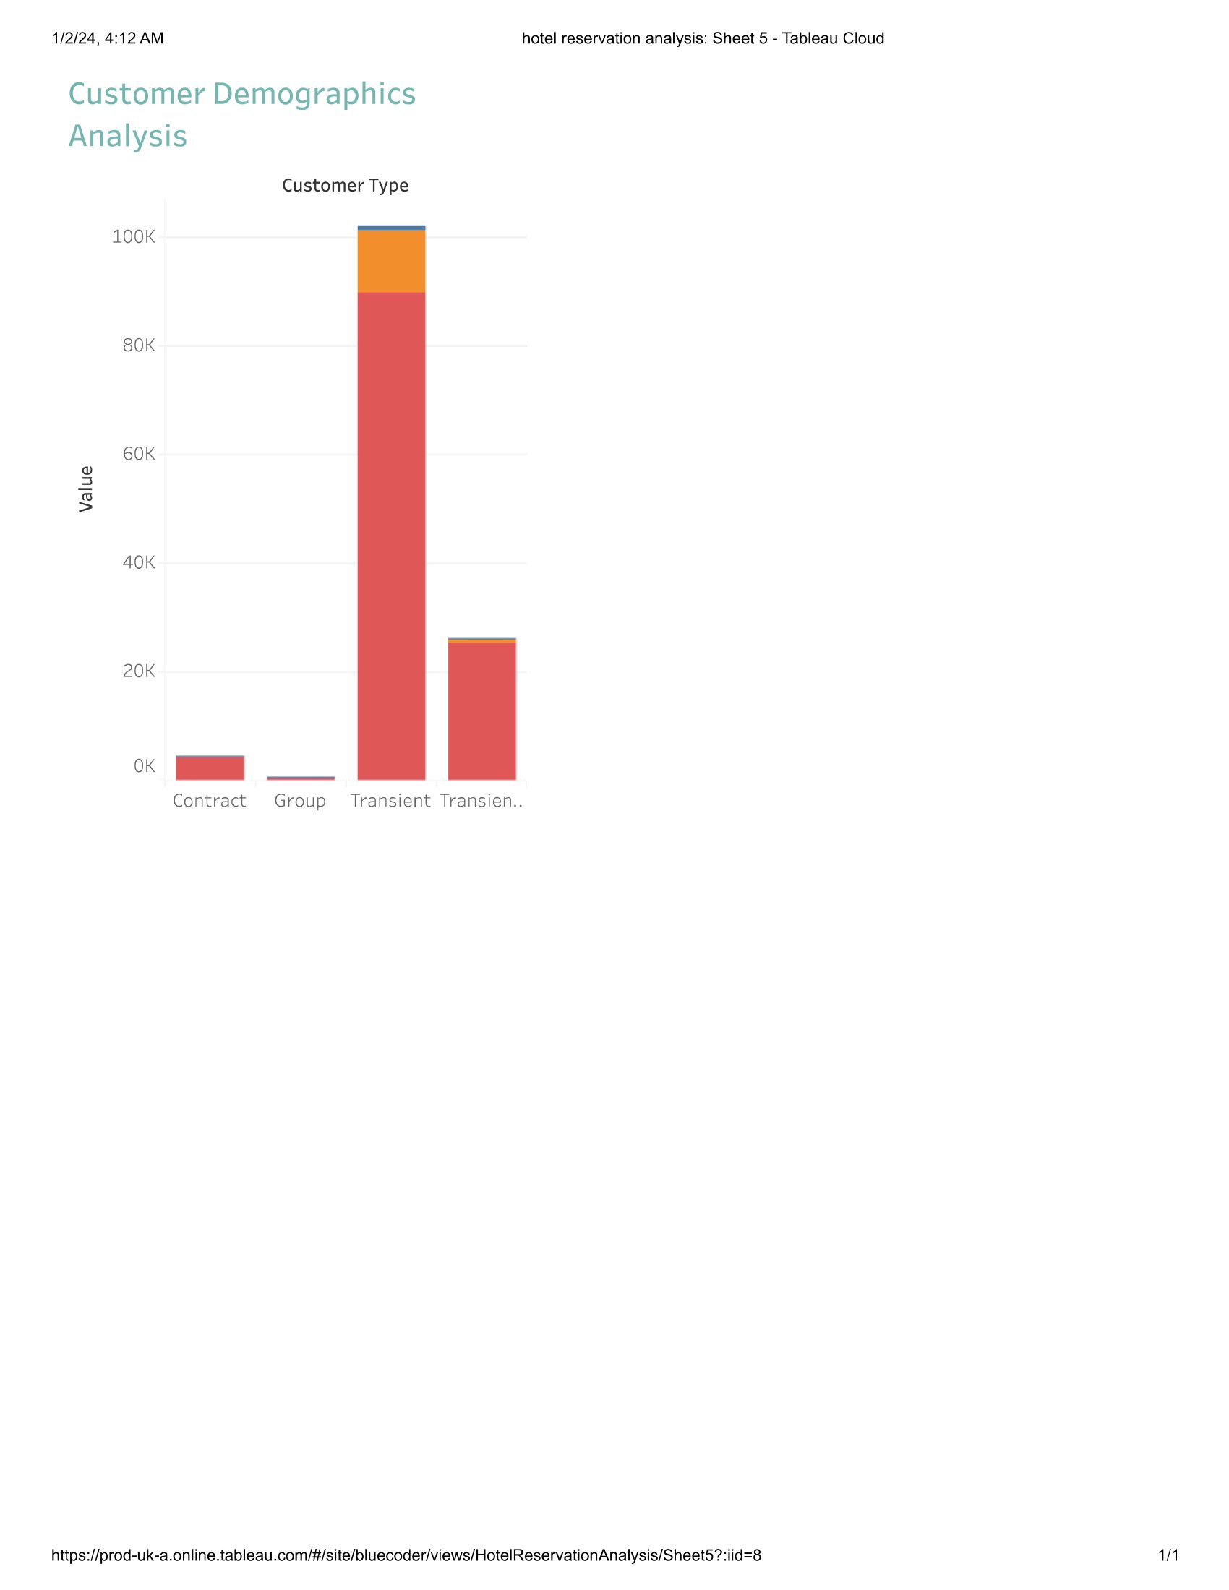
Tableau Stacked Bar Chart presenting customer distribution across demographics (e.g., age groups).
Insights: Diversity within customer segments visiting the hotel.

Slide 6
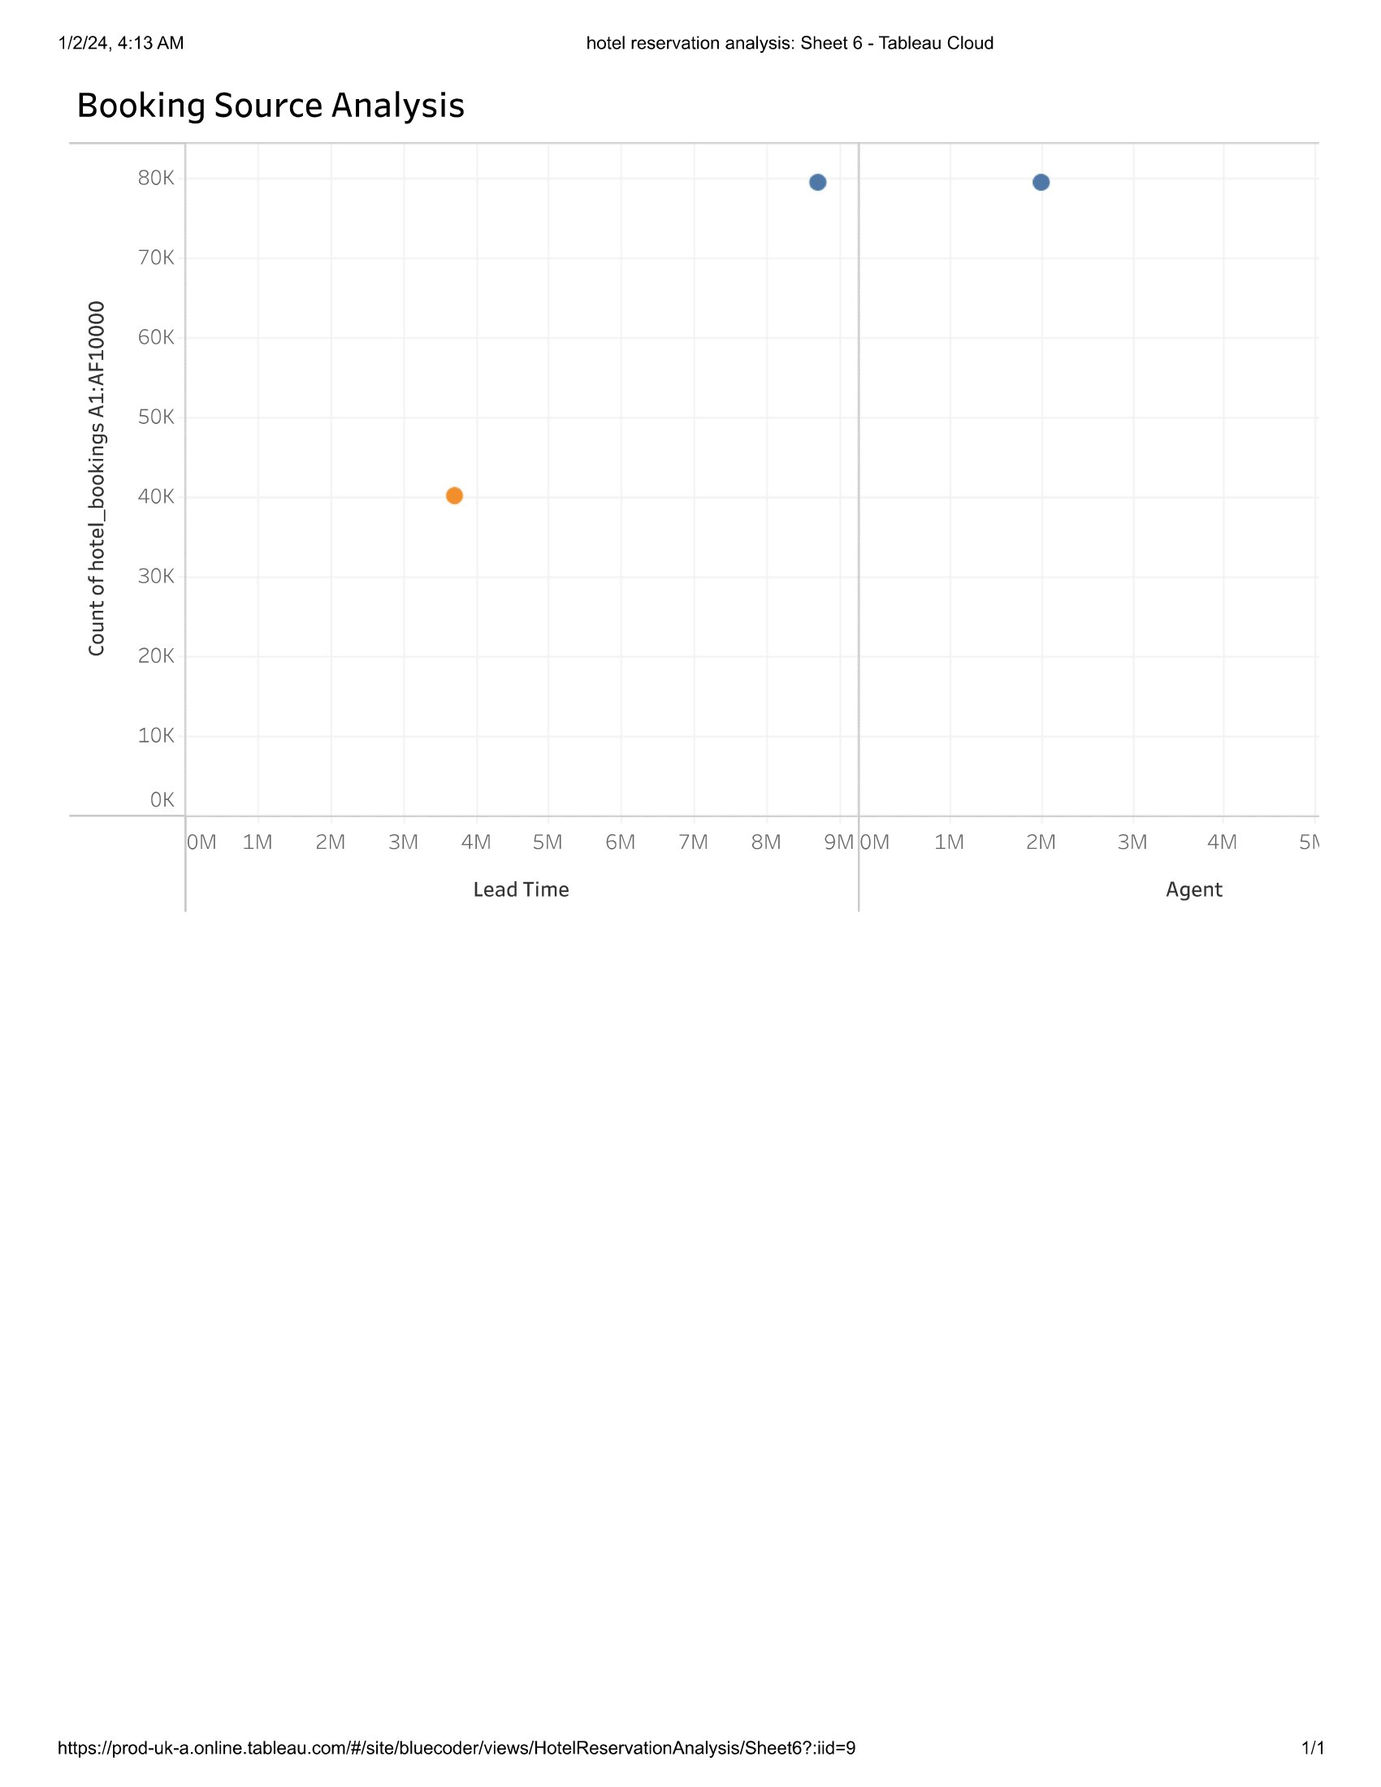
Tableau Pie Chart or Bar Chart displaying contributions of booking sources to total reservations.
Highlights: Significant booking channels for the hotel.

Slide 7
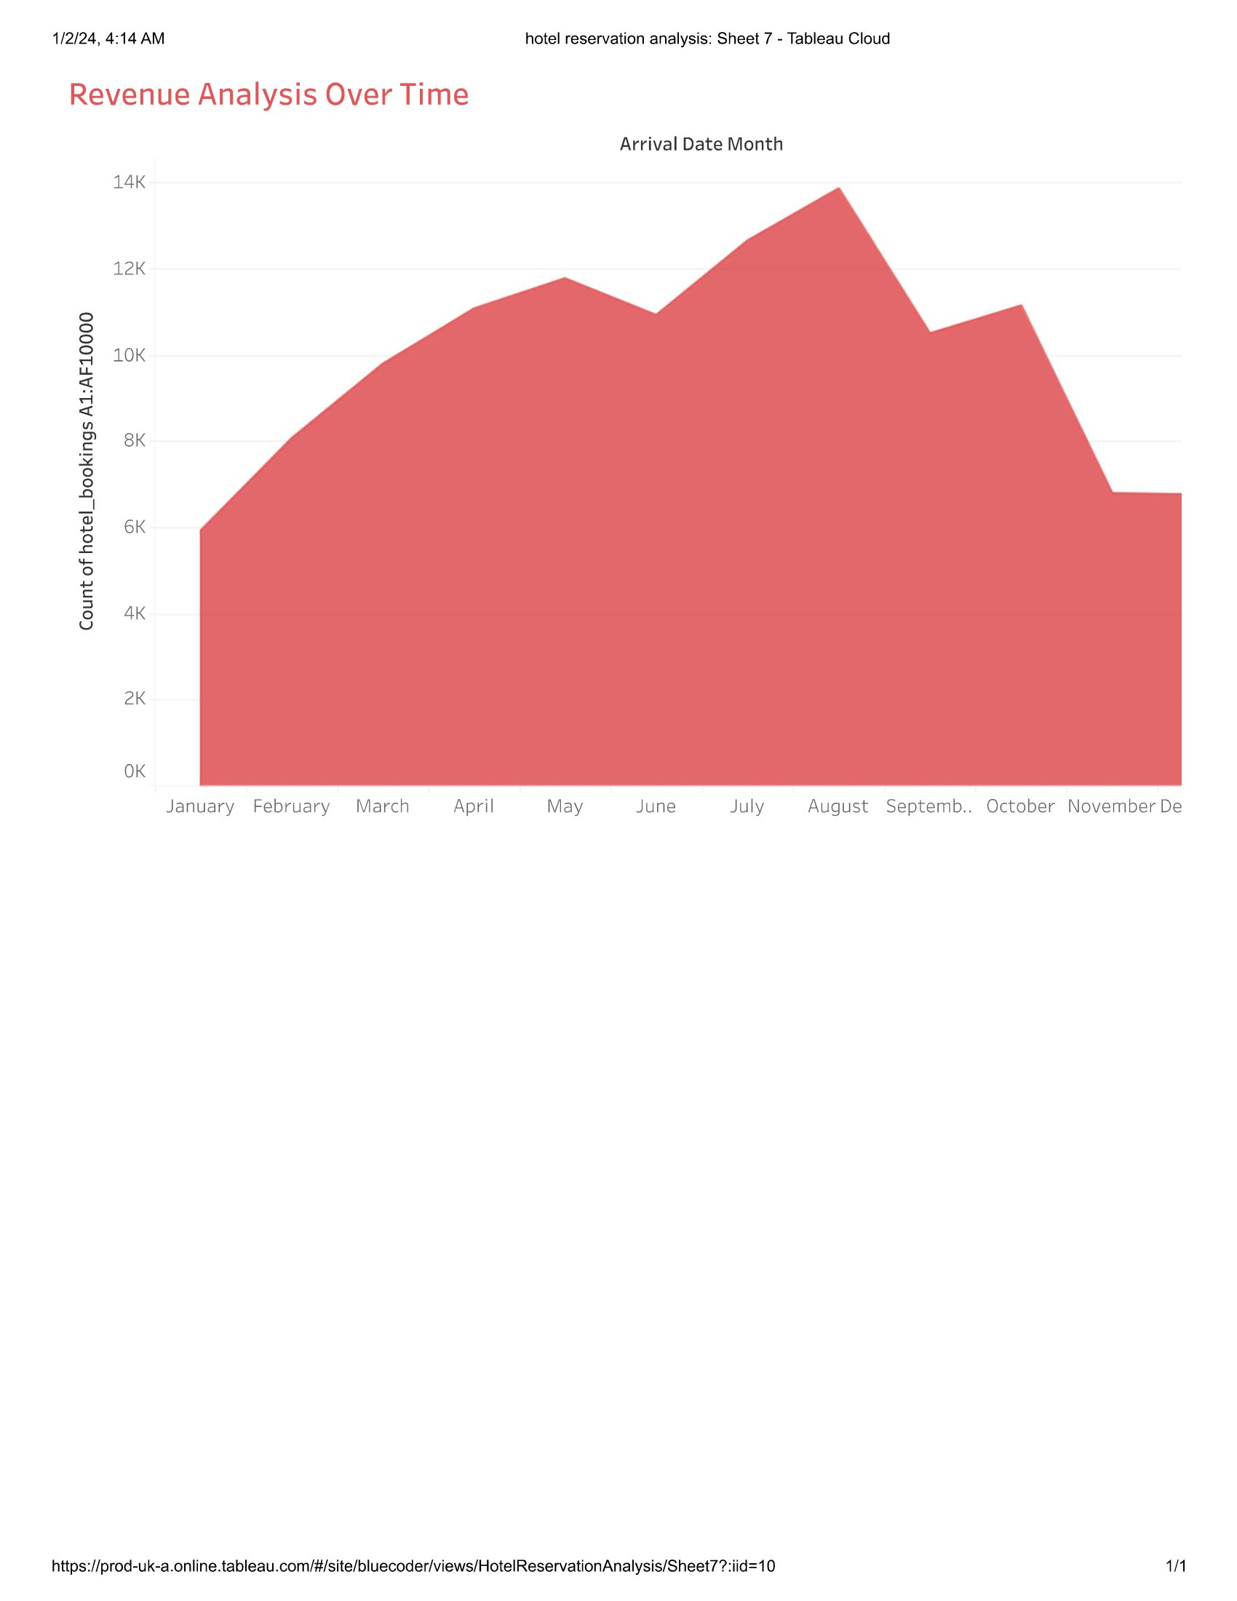
Tableau Area Chart showcasing revenue trends across specific time frames.
Observations: Patterns in revenue fluctuations.

Slide 8
Further Analysis and Actions & Potential Improvements and Future Investigations
This slide suggests actionable steps for further analysis and potential areas for improvement, aiming to drive continuous enhancement and strategic decision-making based on the insights obtained from the hotel reservation analysis in Tableau.
Advanced Segmentation: Explore deeper segmentation within customer demographics to tailor marketing strategies.
Predictive Modeling: Implement predictive models to forecast booking patterns for better resource allocation.
Channel Optimization: Assess and refine booking channels to maximize revenue and minimize dependency on specific sources.
Customer Satisfaction Analysis: Conduct surveys or sentiment analysis to gauge guest satisfaction and enhance services.
Competitive Benchmarking: Compare our performance with industry benchmarks to identify areas for competitive advantage.
Dynamic Pricing Strategies: Investigate dynamic pricing models to optimize room rates based on demand fluctuations.

Slide 9
THANK YOU!

